Slide 1
Version Control Using GIT
Git Basics

Slide 2
Introduction
Version control
CVCS
DVCS
GIT

Slide 3
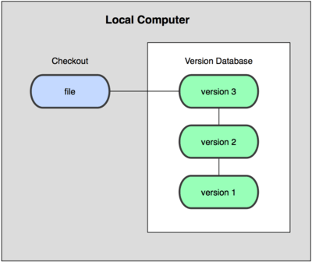
Version Control
Version control is a system that records changes to files
A VCS allows you to manage file history allowing you to:
Rolling back to previous states of a file if something goes wrong
Maintain change logs allowing you compare versioning issues
The simplest form of version control systems are local
e.g. rcs in Mac OS x

Slide 4

Centralised Version Control Systems
Central VCS systems allow multiple developers to collaborate on other systems.
e.g. CVS, Subersion and Perforce
Single server that contains all versioned files
Clients that check out files from this source

Slide 5
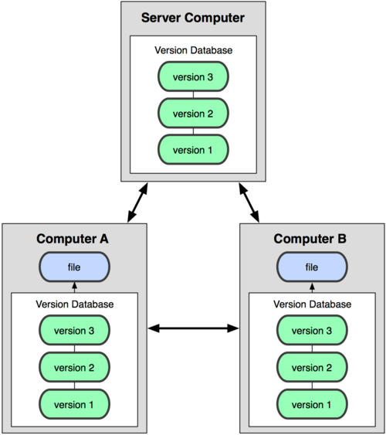
Distributed Version Control Systems
DVCS do not just check out the most local snapshot of a file
They mirror the repository
so each checkout is like a backup of the repository

Slide 6
GIT as a DVCS
GITs origin are in Linux Development and is open source
Its goals were to create a DVCS system that was:
Fast
Simple
Strong support for non-linear development
Fully distributed
Able to handle large projects like the Linux kernel efficiently

Slide 7

Demonstration – Installing GIT
You can get GIT for all major platforms:
Linux: http://git-scm.com/download/linux
Mac: http://git-scm.com/download/mac
Windows: http://msysgit.github.io/

Slide 8
Git Configuration – Setting the User
Git keeps track of who performs version control actions
Git must be configured with your own name and e-mail.
To configure Git with your name and e-mail we use the following commands:
The values can then be accessed using:
You can list all the configurations with:
% git config --global user.name "Your Name"
% git config --global user.email "mail@example.com"
% git config user.xxx
% git config --list

Slide 9
Git User Configuration – Ninja Lab
Use the command line to configure Git with your user name and email
Check the settings to ensure these are set

Slide 10
Git Commands – Entomology
Git commands all follow the same convention:
The word ‘git’
Followed by an optional switch,
Followed by a Git command (mandatory),
Followed by optional arguments
git [switches] <commands> [<args>]
git –p config -–global user.name "Tom"
Notes:
The -p switch paginates the output if needed.

Slide 11
Getting started with Git
When you first launch Git you will be at your home directory
~ or $HOME
Through the Git Bash you can then move through and modify the directory structure
Command | Explanation
ls | Current files in the directory
mkdir | Make a directory at the current location
cd | Change to the current directory
pwd | Print the current directory
rm | Remove a file (optional –r flag to remove a directory)

Slide 12

Git Bash making a directory – Ninja Lab
Launch your git command line
Ensure you are at your home directory
Find the corresponding directory using your GUI file explorer
Create a directory called gitTest
Navigate within the directory using the command line
Create a sub folder
Navigate back to home
Remove the gitTest directory
Once you have completed all other tasks type history

Slide 13
Git Help
git help

Slide 14
Git Help – Ninja Lab
Use your command line to access git help find out about:
help
glossary
-a
config
-g

Slide 15
Conclusion
Git is a multiplatform version control tool
It uses a common command line interface on all major platforms
The Git command line is based on UNIX
The shell we utilise is based upon this

